Slide 1

Module 10 Unit 2
Point to her nose.

Slide 2

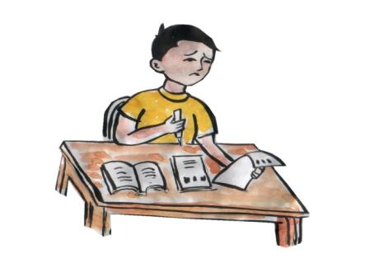
预检{
上堂:What's this? It' a....
新课:Point to your head.
我复习了上堂、预习了新课。请检测吧！

Slide 3


跟我学：
nose
鼻子
A:What's this?
B:It' a
nose

Slide 4
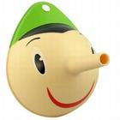
nose

Slide 5


ear
耳朵
PPT模板：www.1ppt.com/moban/ PPT素材：www.1ppt.com/sucai/
PPT背景：www.1ppt.com/beijing/ PPT图表：www.1ppt.com/tubiao/
PPT下载：www.1ppt.com/xiazai/ PPT教程： www.1ppt.com/powerpoint/
资料下载：www.1ppt.com/ziliao/ 范文下载：www.1ppt.com/fanwen/
试卷下载：www.1ppt.com/shiti/ 教案下载：www.1ppt.com/jiaoan/
PPT论坛：www.1ppt.cn PPT课件：www.1ppt.com/kejian/
语文课件：www.1ppt.com/kejian/yuwen/ 数学课件：www.1ppt.com/kejian/shuxue/
英语课件：www.1ppt.com/kejian/yingyu/ 美术课件：www.1ppt.com/kejian/meishu/
科学课件：www.1ppt.com/kejian/kexue/ 物理课件：www.1ppt.com/kejian/wuli/
化学课件：www.1ppt.com/kejian/huaxue/ 生物课件：www.1ppt.com/kejian/shengwu/
地理课件：www.1ppt.com/kejian/dili/ 历史课件：www.1ppt.com/kejian/lishi/
Notes:
PPT模板：www.1ppt.com/moban/ PPT素材：www.1ppt.com/sucai/
PPT背景：www.1ppt.com/beijing/ PPT图表：www.1ppt.com/tubiao/
PPT下载：www.1ppt.com/xiazai/ PPT教程： www.1ppt.com/powerpoint/
资料下载：www.1ppt.com/ziliao/ 范文下载：www.1ppt.com/fanwen/
试卷下载：www.1ppt.com/shiti/ 教案下载：www.1ppt.com/jiaoan/
PPT论坛：www.1ppt.cn PPT课件：www.1ppt.com/kejian/
语文课件：www.1ppt.com/kejian/yuwen/ 数学课件：www.1ppt.com/kejian/shuxue/
英语课件：www.1ppt.com/kejian/yingyu/ 美术课件：www.1ppt.com/kejian/meishu/
科学课件：www.1ppt.com/kejian/kexue/ 物理课件：www.1ppt.com/kejian/wuli/
化学课件：www.1ppt.com/kejian/huaxue/ 生物课件：www.1ppt.com/kejian/shengwu/
地理课件：www.1ppt.com/kejian/dili/ 历史课件：www.1ppt.com/kejian/lishi/

Slide 6

ears

Slide 7

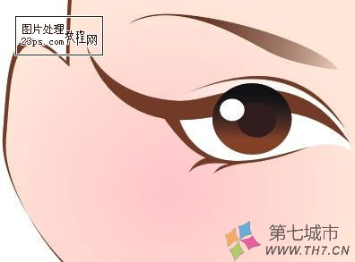
eye
眼睛

Slide 8

eyes

Slide 9
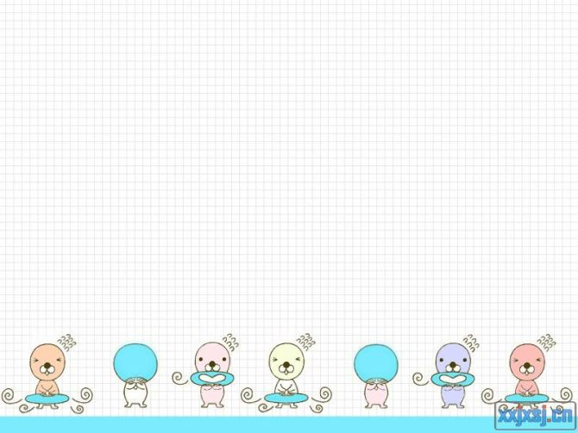

mouth
嘴巴

Slide 10

mouths

Slide 11

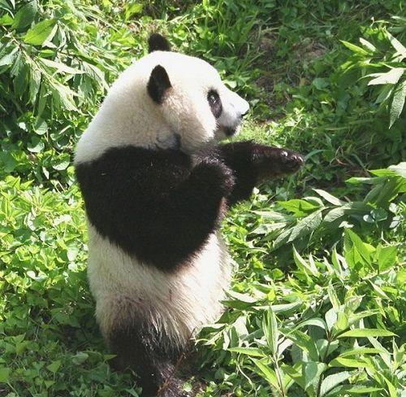
情景加深：
hand
This is his hand.

Slide 12
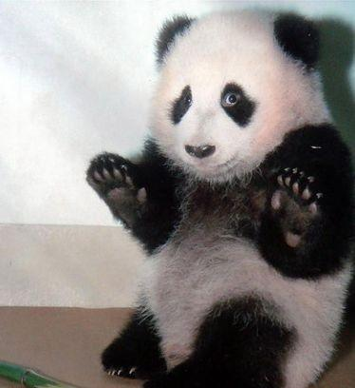
leg
This is his leg.

Slide 13
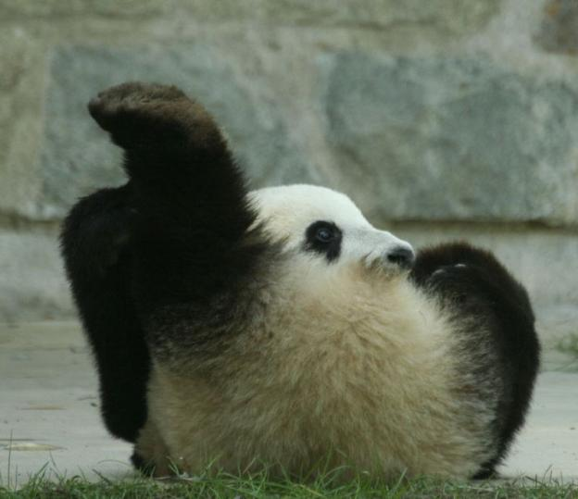
foot
This is his foot.

Slide 14

精讲点拨：
mouth
嘴巴
eye
眼睛
nose
鼻子
ear
耳朵
hand
手
head
头
leg
腿
arm
手臂
foot
脚

Slide 15
拓展训练：（演练）
Point and say

Slide 16


Slide 17

eyes
ears
nose
mouth

Slide 18











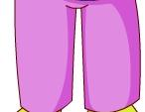

合作交流：
Point to your head.

Slide 19


创新演练：
青蛙跳伞

Slide 20
nose
eye
eye
眼睛
leg
鼻子
嘴巴
耳朵
head
hand
foot
nose
ear
mouth
大家真棒!

Slide 21
拓展延伸：
her 与 his的区别

Slide 22

Her name is Mary.

Slide 23
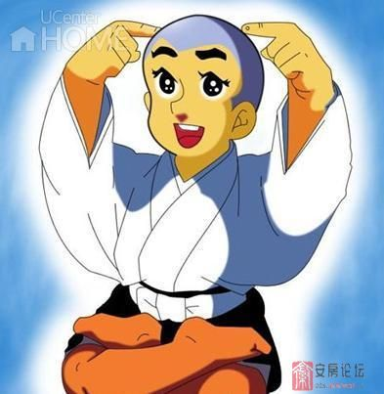
his name is Yixou.

Slide 24
her
她的
her book
她的书
This is her pen.
这是她的钢笔。

Slide 25

堂堂清：

Slide 26

eye
mouth
hand
head
ear
nose
手
耳朵
鼻子
眼睛
头
嘴巴

